Slide 1
COMPREHENSIVE PLANNING PROCESS
To assist churches to develop a vision for the future and determine action steps to pursue the vision to its fulfillment

Slide 2
COMPREHENSIVE PLANNING PROCESS
Session 1: Searching for Life

Slide 3
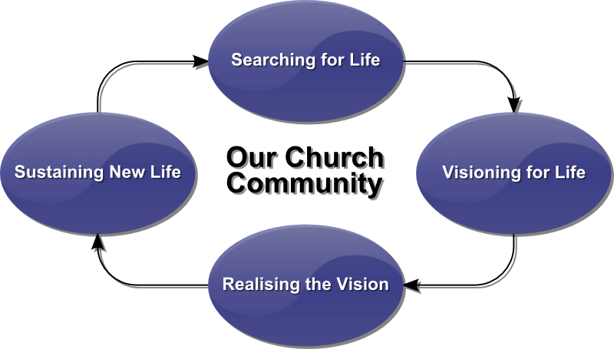
SESSION 1: SEARCHING FOR LIFE

Slide 4
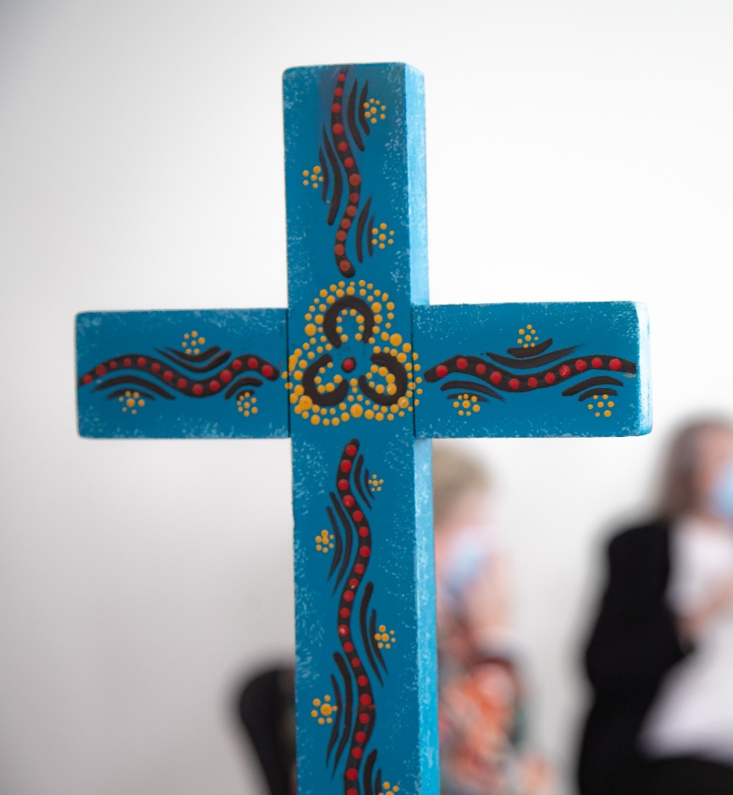
Jesus Christ and his promise of life, his presence as life, is at the core of every congregation
In the midst of all our communities Jesus is:
  the Bread of life (John 6:35)
  the Way, the Truth and the Life (John 14:6)
  the Resurrection and the Life (John 11:25)
  the Living Water (John 4:11)
  the Light of Life (John 8:12)

Slide 5
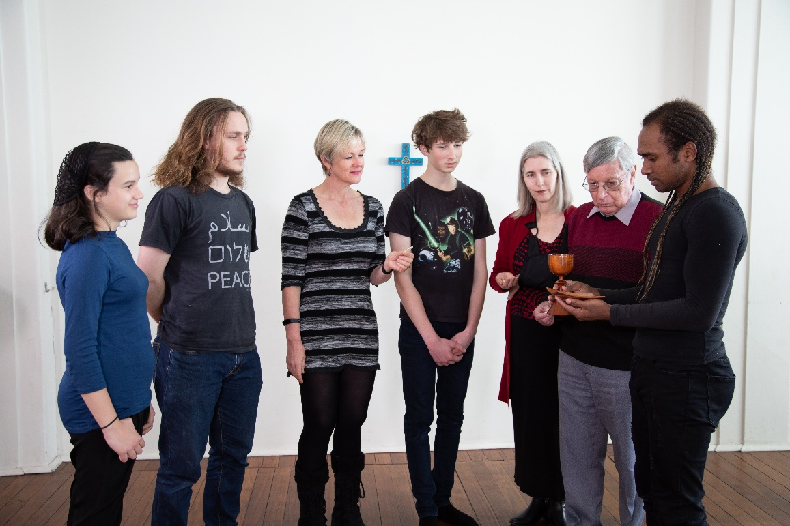
LOOK FOR LIFE
“I came that they might have life and have it to the full.” John 10:10
Where do we see the Life?
Where do we see the Life in abundance?

Slide 6
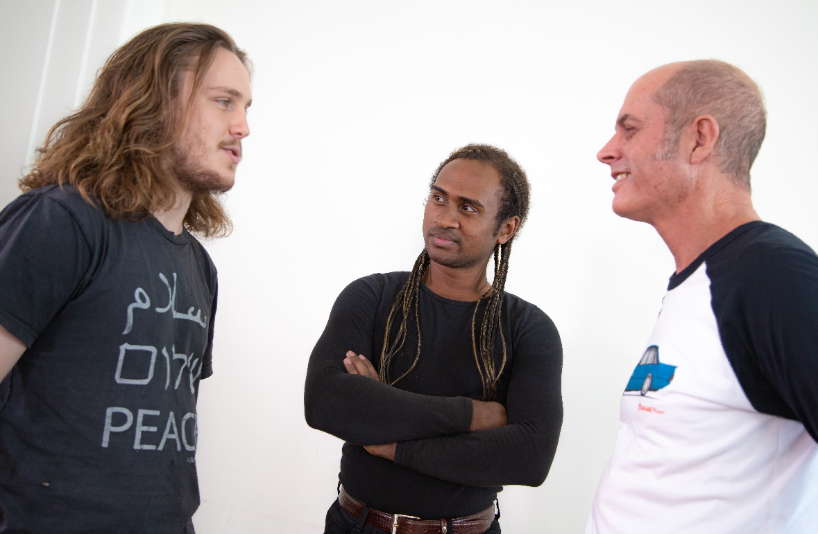
SEARCHING FOR LIFE
One on one sharing stories of “the best” and what gives life
Small groups discerning themes, core images, locating positive energy for change

Slide 7
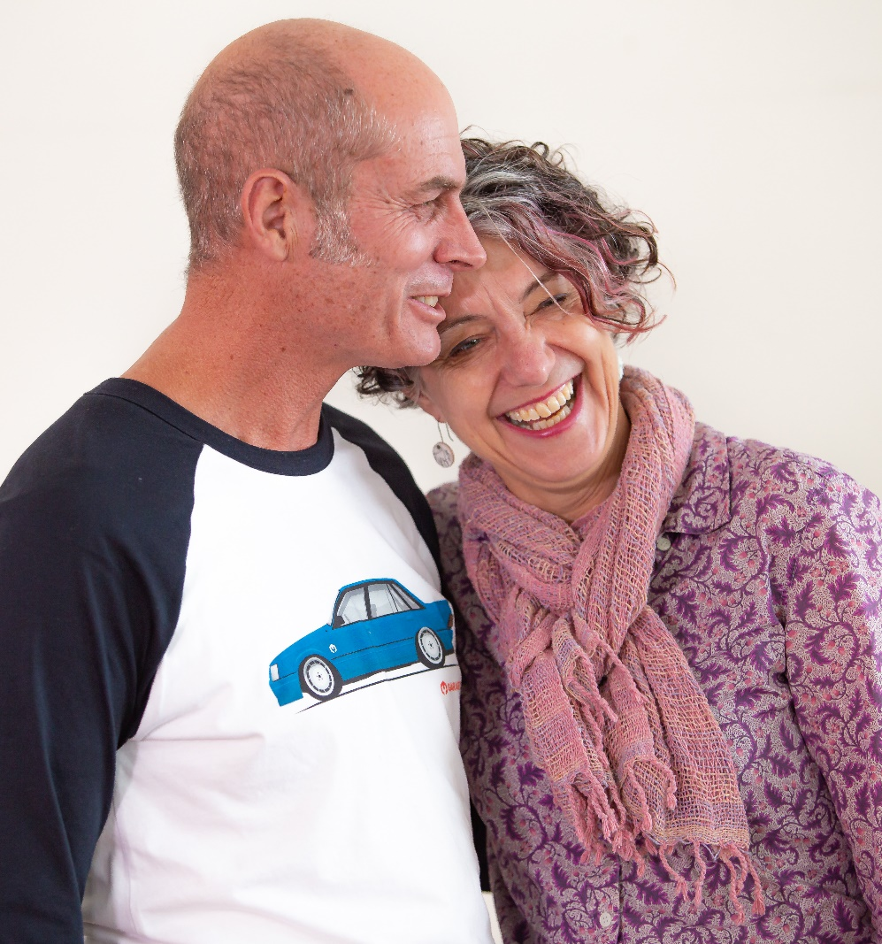
Searching for Life
Interview one another:
  “Where have you found life in this church community?”
  “When is our church community at its best?”

Slide 8
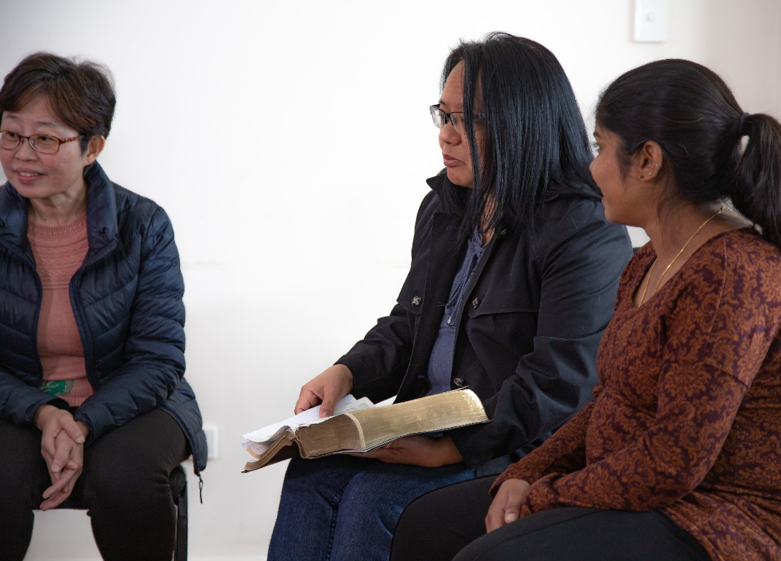
SEARCHING FOR LIFE
Small Group Discernment:
  “Where are the sources of Life in our church community?”

Slide 9

SEARCHING FOR LIFE
Presentation & Discussion:
  Our Church Life Profile shows our survey results

Slide 10
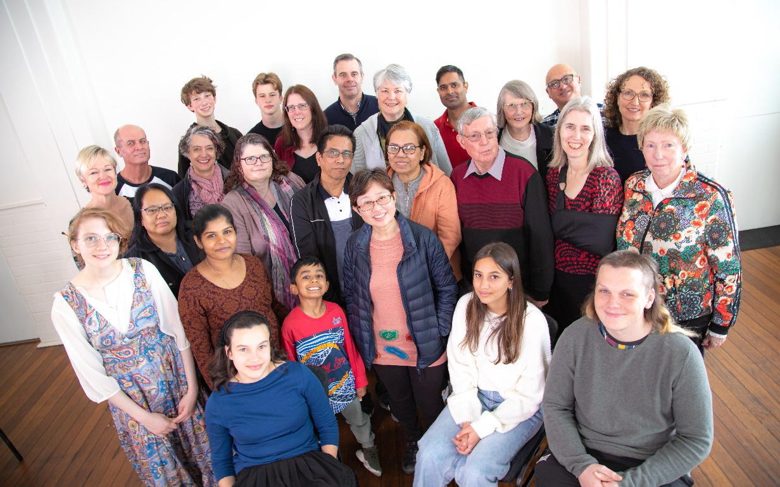
SEARCHING FOR LIFE
Plenary Discernment
The five core sources of Life for our church community

Slide 11
Thank you for completing
Session 1: Searching for Life
Sessions to follow:
2. Visioning for Life
3. Realising the Vision
4. Sustaining New Life

Slide 12
COMPREHENSIVE PLANNING PROCESS
Session 2: Visioning for Life

Slide 13
Session 2: Visioning for Life

Slide 14
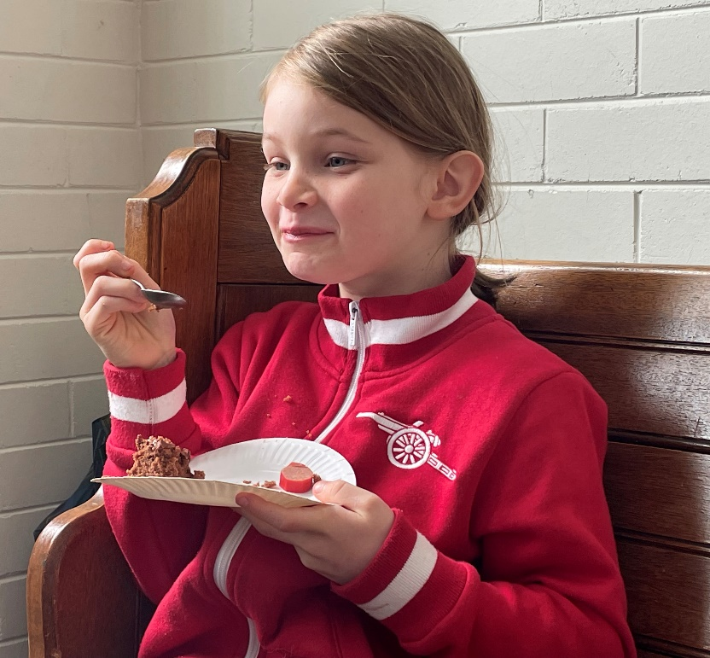
Lead for Life
“I came that they might have life and have it to the full.” John 10:10
Visioning that sees, reverences and fosters the sacredness of life! (people’s gifts, energy, initiative, creativity)
– that builds hope!

Slide 15
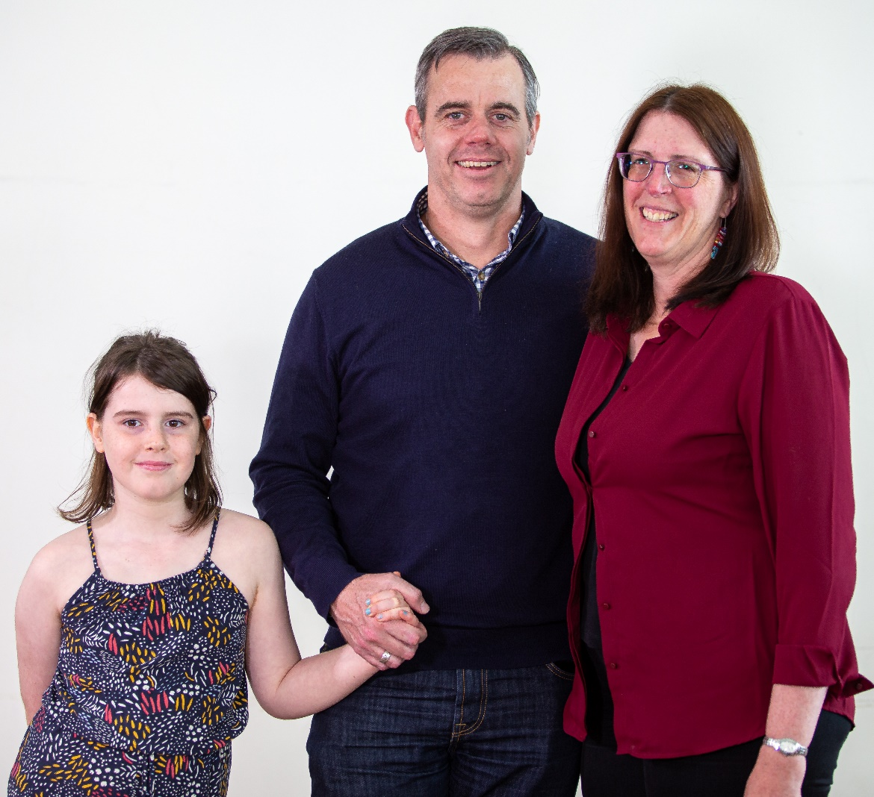
Visioning for Life
  Imagine a shared picture of a preferred future
  Collective visioning

Slide 16
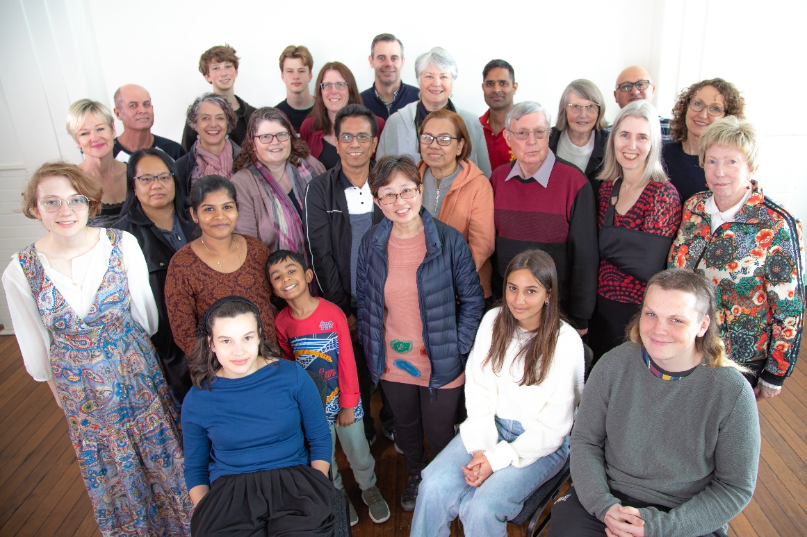
Visioning
“Every day the Church gives birth to the Church”
Venerable Bede

Slide 17
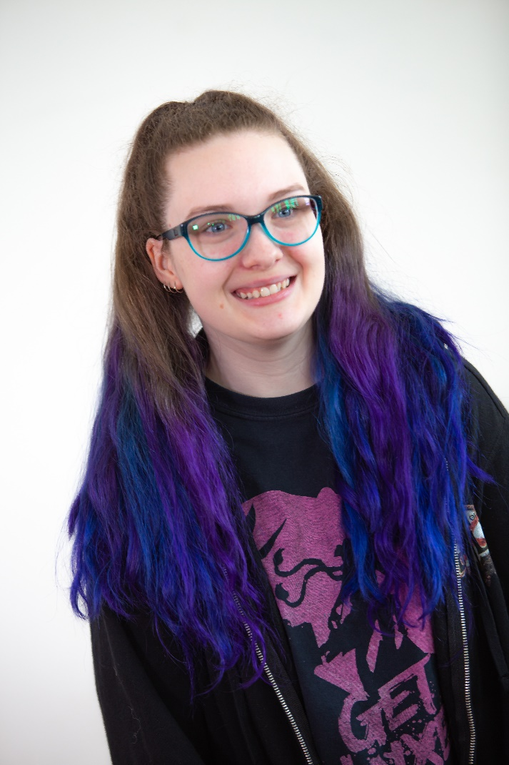
Imagination
“Every good idea and all creative work is the offspring of the imagination... it is in the imagination that the most valuable promise of a person may lie”
Carl Jung

Slide 18
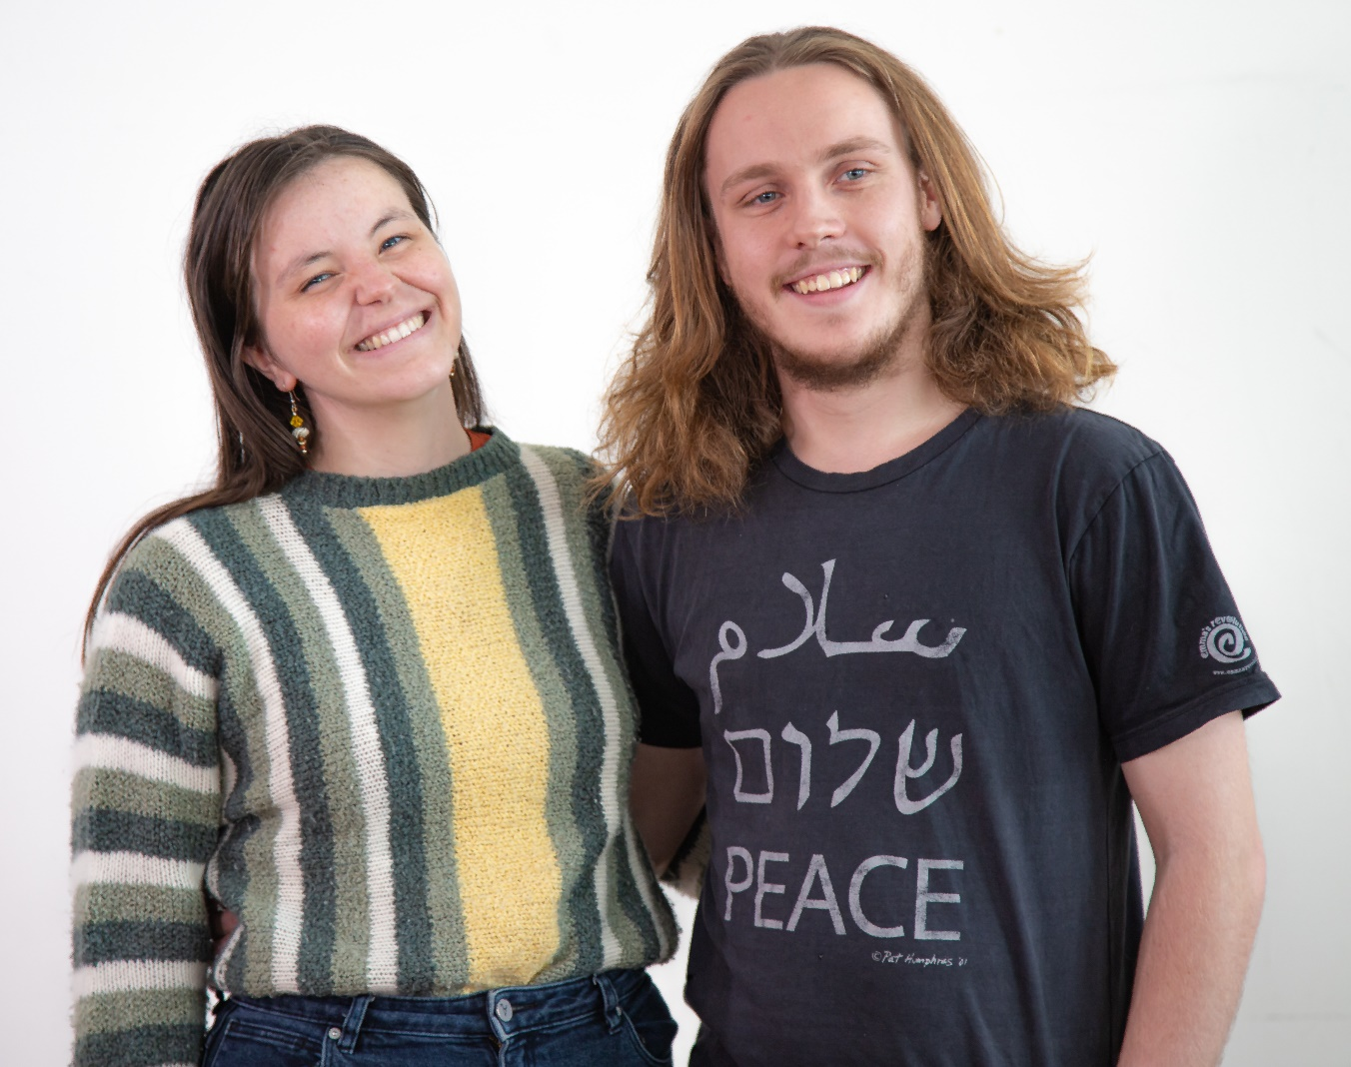
Visioning
Visions are:
  aspirational –
  beyond present horizons
  inspirational –
  emotionally spur us on

Slide 19
Vision Statements
“A man on the moon by the end of the 1960’s”
NASA
“A Coke within arm’s reach of every person on the planet”
Coca Cola Co
“That each person may find Christ so that Christ may walk with each person the path of life”
John Paul II

Slide 20
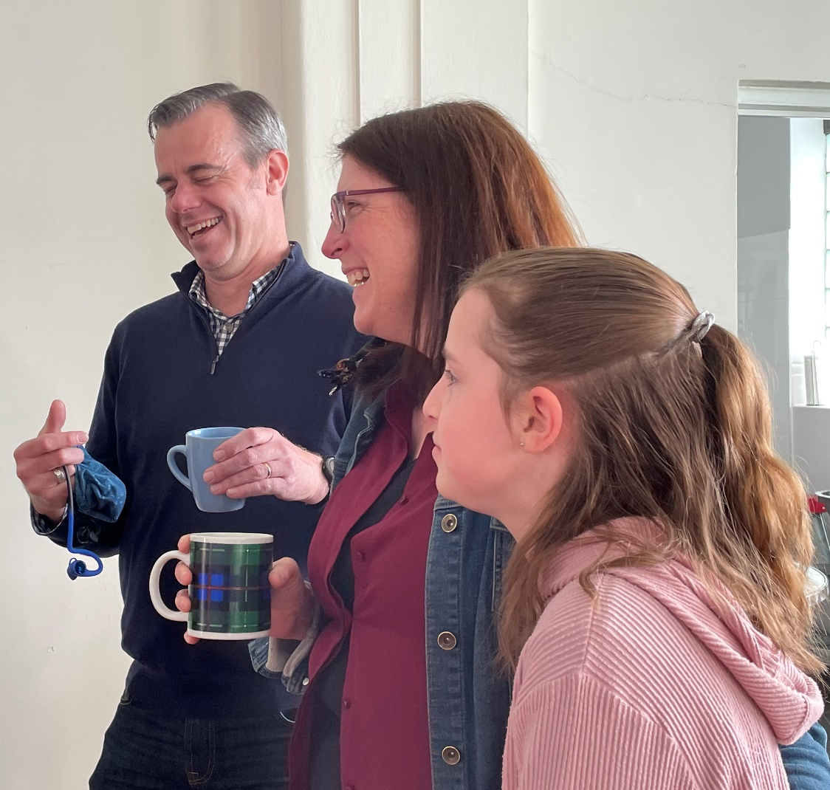
Parrhesia
  Speaking freely
  Boldness in the Spirit
“Since, then, we have such a hope, we act with great boldness”
2 Corinthians 3:12

Slide 21
Visioning
Christian Herald
24 March 2022
St Jude’s Second Home
for Young Families
Parish has integrated program to embrace and nurture families with young children.
Creche and Sunday School at worship
Wednesday inter-church toddlers’ group and coffee club
Rotating group dinner (early!) in homes with sharing on Christian parenthood
  Share the three wishes from interviews
  Imagine church community 2020
    What will be happening
    Where will this be happening
    What will be different from now
  Write a 2020 headline and points for the story

Slide 22
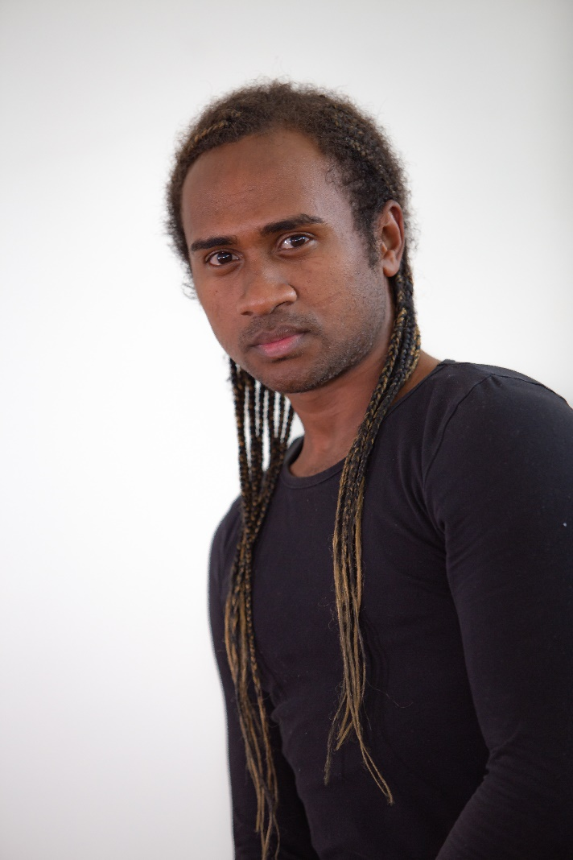
Vision Preference
  What is attractive about this vision?
  Will it meet our heartfelt desires?
  Does it reflect parrhesia?
  Is it realistic and achievable?

Slide 23
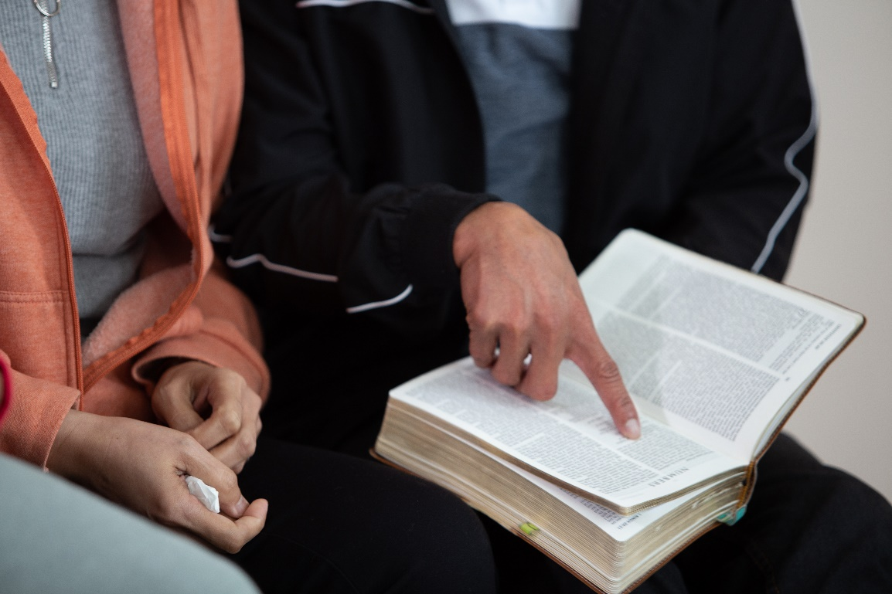
Visioning
A Vision that is:
  aspirational –
  beyond present horizons
  inspirational –
  emotionally spur us on

Slide 24
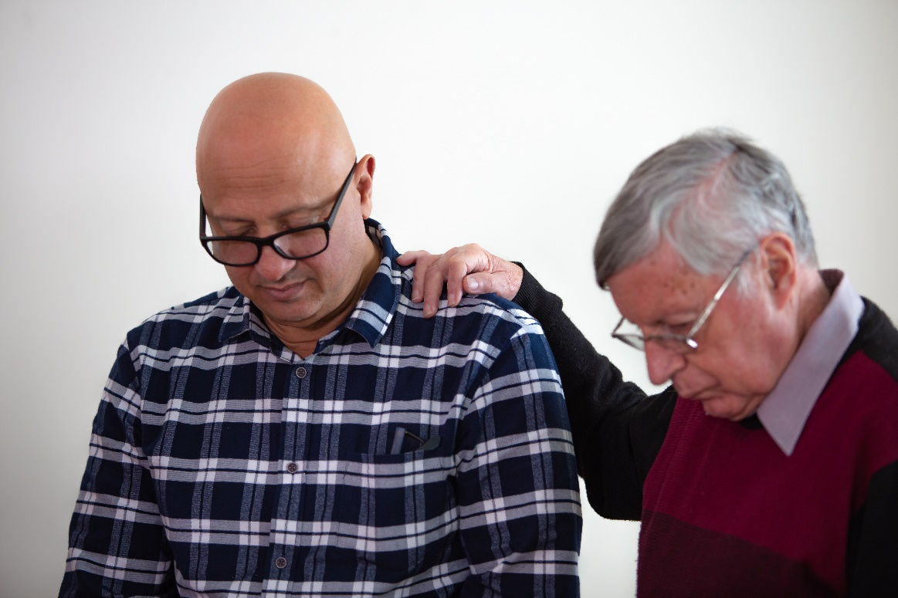
Have ears that will hear the prophetic voice

Slide 25
Thank you for completing
Session 2: Visioning for Life
Sessions to follow:
3. Realising the Vision
4. Sustaining New Life

Slide 26
COMPREHENSIVE PLANNING PROCESS
Session 3: Realising the Vision

Slide 27
Session 3: Realising the Vision

Slide 28

Realising the Vision
  Plan the goals and steps that will make the vision a reality
  Adapt the organisational structure of the local church to support our goals and steps

Slide 29
Key Planning Principles
  Positive principle
  Proximity principle
  Partnership principle

Slide 30

Realising the Vision
Goals are the steps we take to move us from our reality towards our Vision

Slide 31
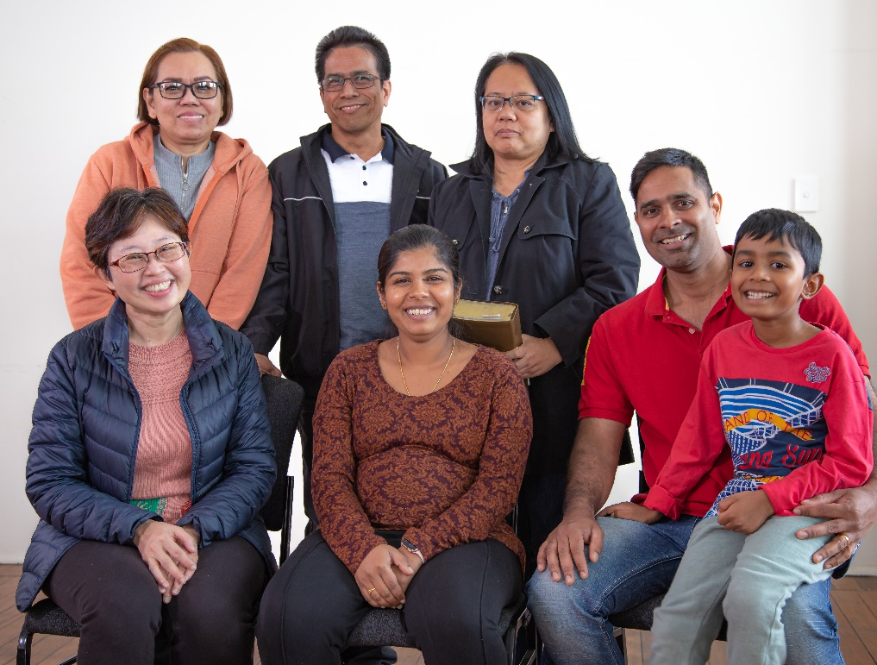
Goals are SMART
Specific
Measurable
Achievable
Relevant
Time bound

Slide 32
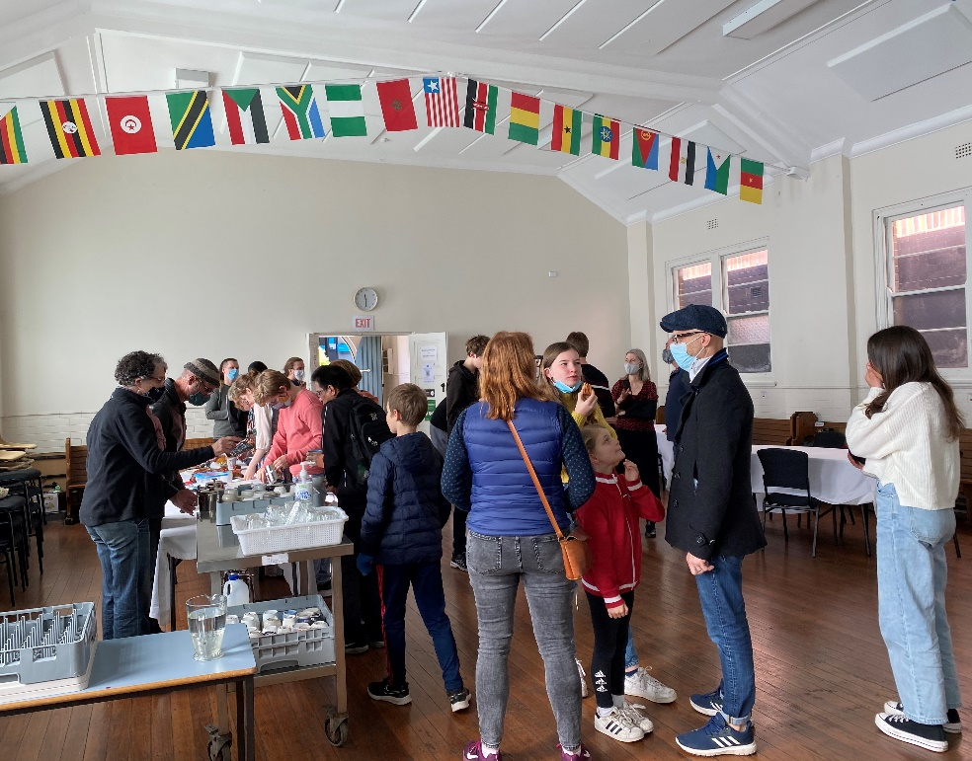
Realising the Vision
  Do any of these goals get in the way of other goals?
  Prioritise the goals to fit our resources.
  Develop Strategies for each goal –
  Who is going to do What? When? How?

Slide 33
Thank you for completing
Session 3: Realising the Vision
Sessions to follow:
4. Sustaining New Life

Slide 34
COMPREHENSIVE PLANNING PROCESS
Session 4: Sustaining New Life

Slide 35
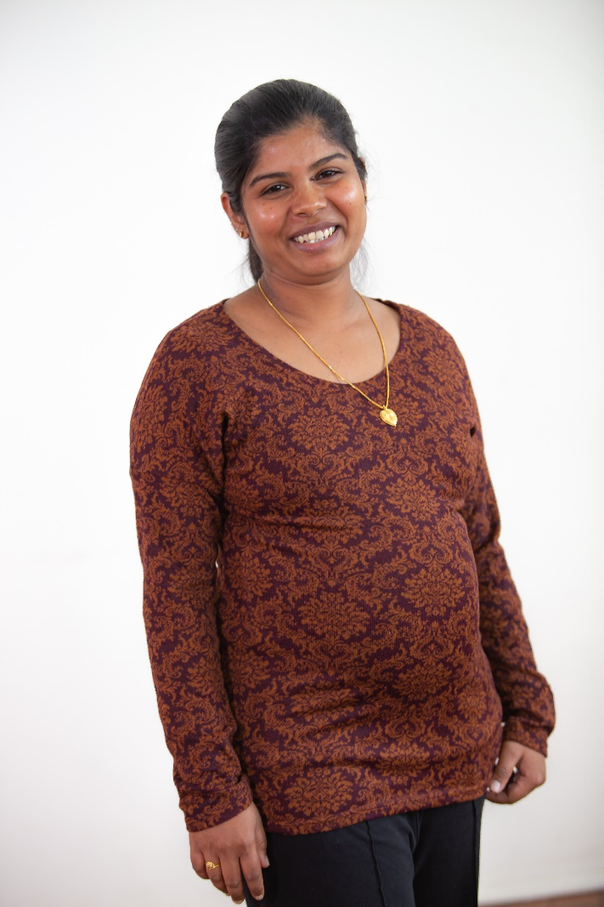
Sustaining New Life
“I came that they might have life and have it to the full.” John 10:10
Sustaining new Life –
sustaining abundant Life

Slide 36
Session 4: Sustaining New Life

Slide 37
Key Planning Principles
  Positive principle
  Proximity principle
  Partnership principle

Slide 38
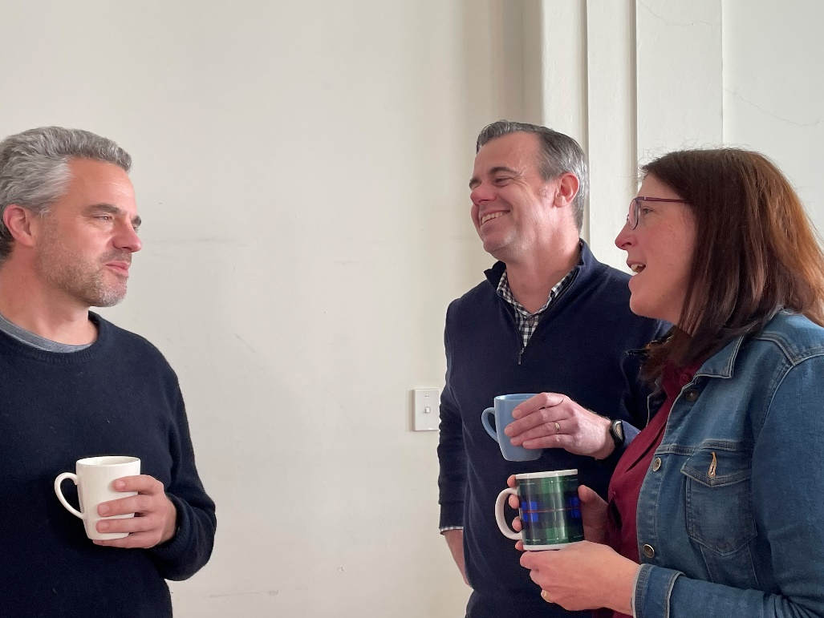
Sustaining New Life
  Put in place processes to learn, adjust, innovate as we implement
  Decide how we will know when we have been successful
  Plan a Church Life Survey in the future to update and track progress

Slide 39
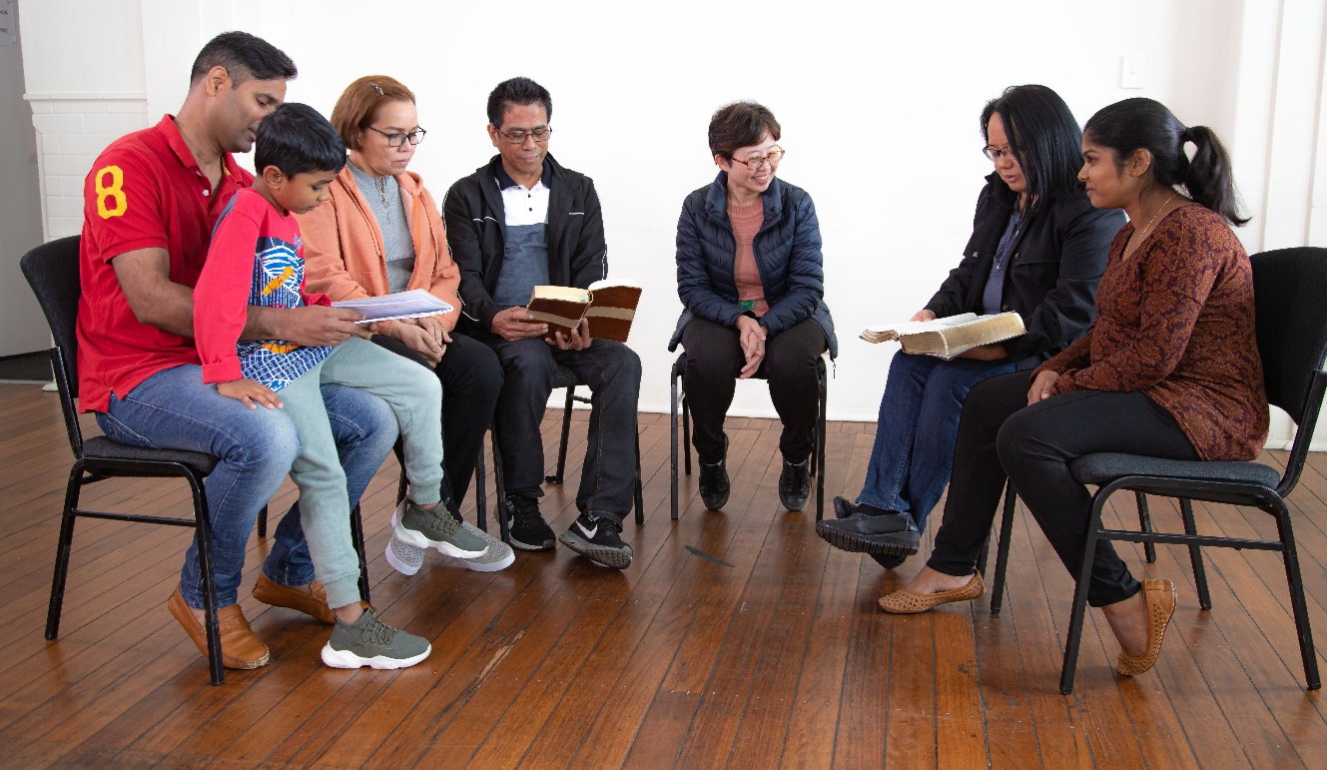
Sustaining New Life
Set up four teams to:
  Communicate the plan
  Celebrate the achievements
  Monitor the implementation
  Evaluate the outcomes

Slide 40
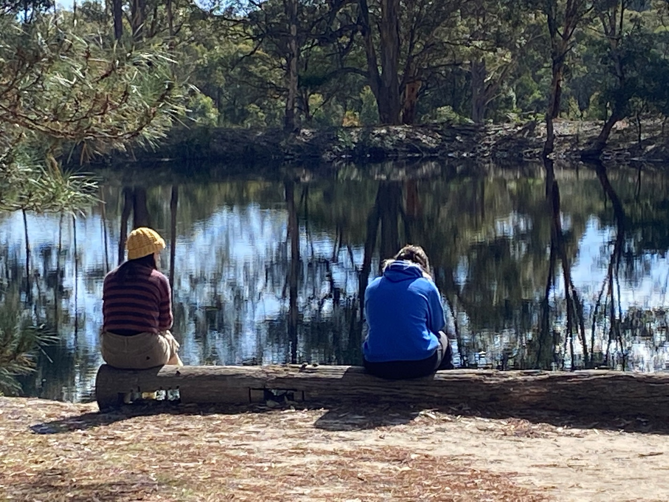
Sustaining New Life
…keep the dream alive

Slide 41
Thank you for completing
Session 4: Sustaining New Life
That completes the Comprehensive Planning Process

Slide 42



info@ncls.org.au | 02 9139 2525 | ncls.org.au

