Slide 1
REFLECTION ACTION
PLANNING PROCESS
For churches to move directly from their
Church Life Profile to steps of action

Slide 2
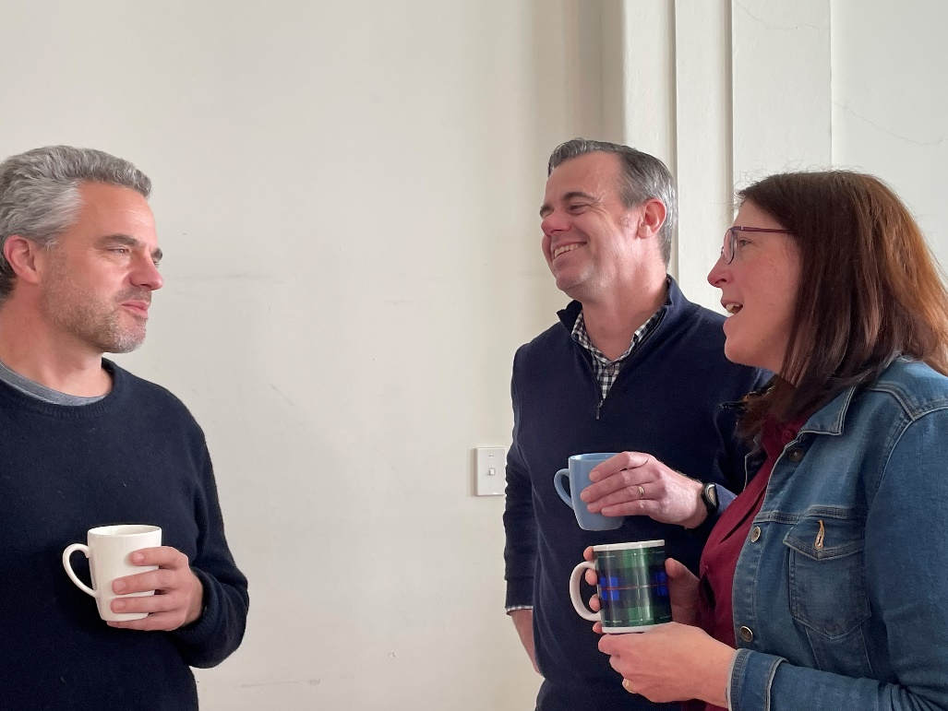
Two Sessions
SESSION 1:
Choose 3 Core Qualities for immediate attention
SESSION 2:
Plan the action steps

Slide 3

AIM for Session 1
The aim of the session is to identify up to three Core Qualities that will receive immediate attention from the church.

Slide 4

Steps for Session 1
1. Explore
Explore our Church Life Profile
2. Choose
Choose 3 Core Qualities to develop further
3. Explore
Explore the ‘sources of life’ in these 3 Qualities
4. Report
Report back & general discussion

Slide 5
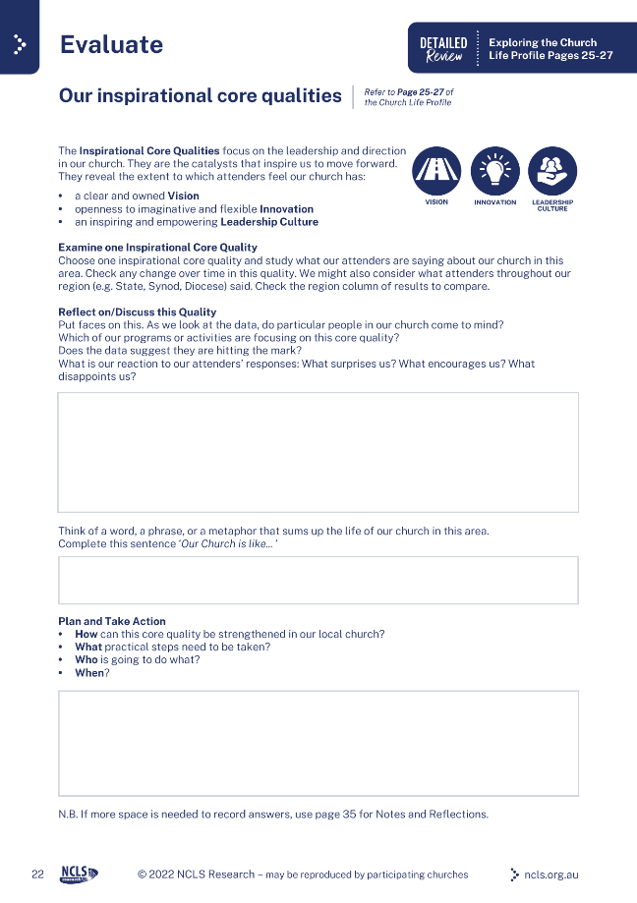


Session 1: EXPLORING OUR PROFILE
Explore our Church Life Profile. Look over our results in each Core Quality of church health.
To form an overview of the 9 Core Qualities at our church, use the Worksheets on pages 20-22 of the Workbook.
To focus on our overall strengths in these Qualities,
use the Worksheet on page 18.
To explore our changes over time in these Qualities,
use the Worksheet on page 19.

Slide 6
Session 1: CHOOSING 3 CORE QUALITIES
Choose 3 Core Qualities to develop further
Explore the ‘sources of life’ in those 3 Qualities
  What has been your best experience of this?
  What was happening? Who was involved? Tell the story
  How was this life-giving for you?
  In what way was it a sign of the life you look for in the church?
Report back and general discussion

Slide 7
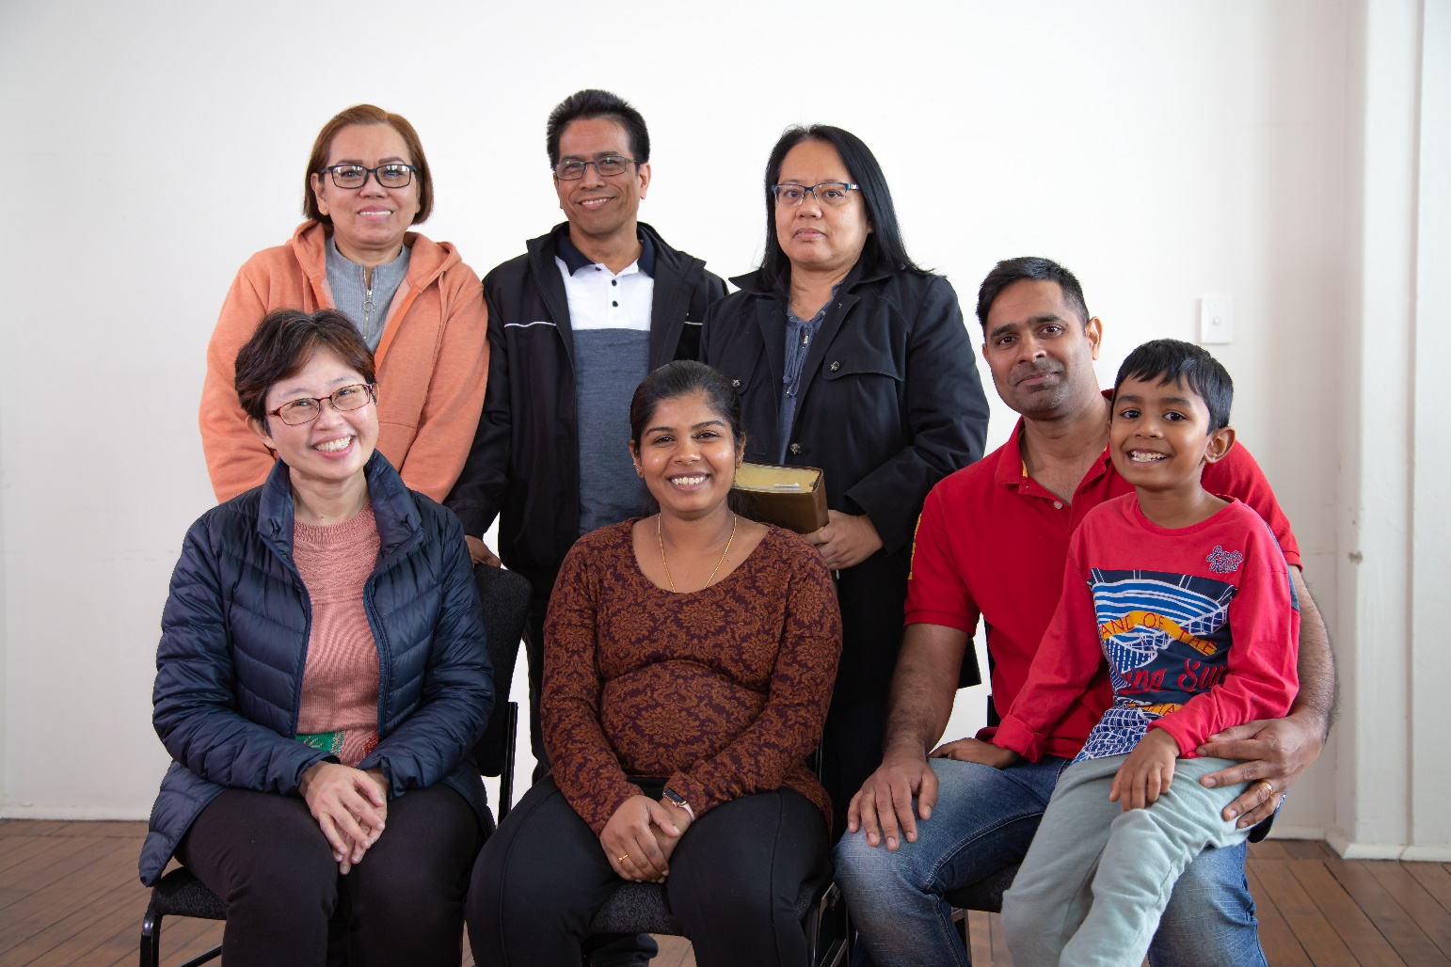
AIM for Session 2
In the previous session, up to three Core Quality areas were identified that our church intends to work on, along with some of the sources of life in our church. The aim of this next session will be to arrive at some action steps to take these areas forward.

Slide 8

STEPS FOR Session 2
1.Identify
Identify our mission focus
2.Decide
Decide on action steps
3. List
List action steps to make it happen
4. Report
Report back, affirm action steps, plan who will take responsibility for implementation

Slide 9
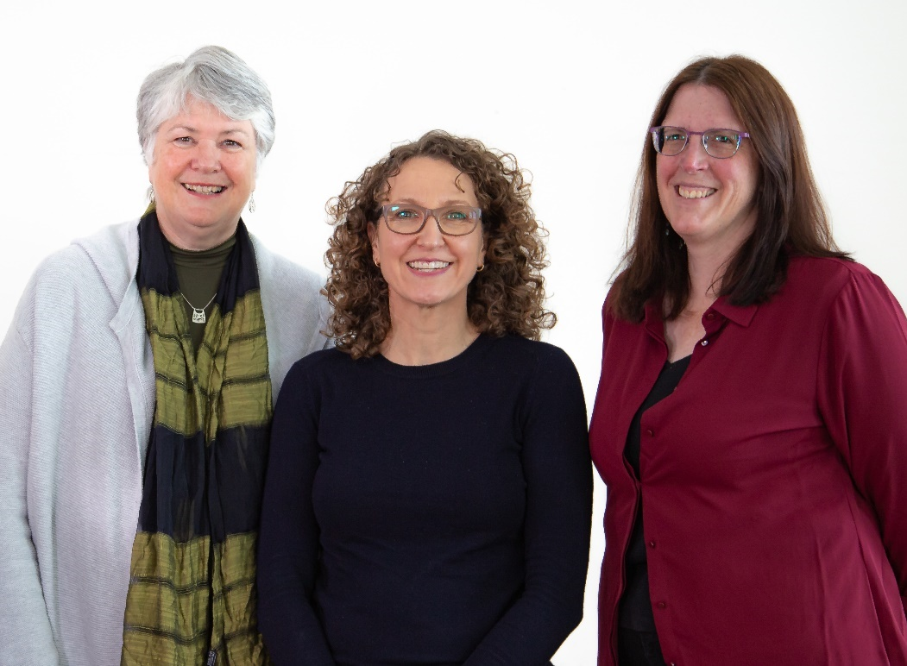
Session 2: IDENTIFYING OUR MISSION FOCUS
Identify our mission focus
Break into groups, one group per Core Quality.
Before identifying potential action steps, consider: Which people groups are priorities for our church’s mission? e.g. young families, retirees, high-school students, new residents, participants in church outreach activities.
Where action steps involve mission to particular groups of people, ask: How will this action step actually help us to better connect with these people?

Slide 10
Session 2: Deciding on Action steps
Decide on action steps
Break into groups, one group per Core Quality.
Regarding a particular Core Quality:
Which aspect of the Core Quality do we work on?
What is already happening in this aspect?
What steps do we need to take to develop this Quality? How will these steps connect with our priority groups?
Who will do it?

Slide 11
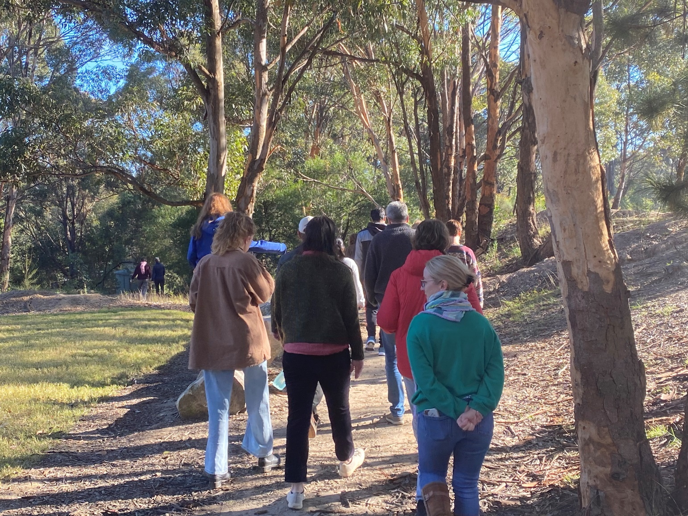
Session 2: MAKING IT HAPPEN
List action steps to make it happen
Report back, affirm the action steps, plan who will take responsibility for implementation

Slide 12



info@ncls.org.au | 02 9139 2525 | ncls.org.au

